Slide 1
Introduction to Linear Programming
Chapter 3 from L. Winston
Copyright (c) 2004 Brooks/Cole, a division of Thomson Learning, Inc.

Slide 2
Linear Programming
Linear programming (LP) is a tool for solving optimization problems.
In 1947, George Dantzig developed an efficient method, the simplex algorithm, for solving linear programming problems (also called LP)
Since the development of the simplex algorithm, LP has been used to solve optimization problems in industries as diverse as banking, education, forestry, petroleum, and trucking.

Slide 3
Example 1: Giapetto’s Woodcarving
Giapetto’s, Inc., manufactures wooden soldiers and trains.
  Each soldier built:
    Sell for $27 and uses $10 worth of raw materials.
    Increase Giapetto’s variable labor/overhead costs by $14.
    Requires 2 hours of finishing labor.
    Requires 1 hour of carpentry labor.
  Each train built:
    Sell for $21 and used $9 worth of raw materials.
    Increases Giapetto’s variable labor/overhead costs by $10.
    Requires 1 hour of finishing labor.
    Requires 1 hour of carpentry labor.

Slide 4
Ex. 1 - continued
Each week Giapetto can obtain:
  All needed raw material.
  Only 100 finishing hours.
  Only 80 carpentry hours.
Demand for the trains is unlimited.
At most 40 soldiers are bought each week.
Giapetto wants to maximize weekly profit (revenues – costs).
Formulate a mathematical model of Giapetto’s situation that can be used maximize weekly profit.

Slide 5
Example 1: Solution
The Giapetto solution model incorporates the characteristics shared by all linear programming problems.
  Decision variables should completely describe the decisions to be made.
    x₁ = number of soldiers produced each week.
    x₂ = number of trains produced each week.
  The decision maker wants to maximize (usually revenue or profit) or minimize (usually costs) some function of the decision variables. This function to maximized or minimized is called the objective function.
    For the Giapetto problem, fixed costs do not depend upon the the values of x₁ or x₂.

Slide 6
Ex. 1 - Solution continued
Giapetto’s weekly profit can be expressed in terms of the decision variables x₁ and x₂:
Weekly profit =
  weekly revenue – weekly raw material costs – weekly variable costs = 3x₁ + 2x₂
Thus, Giapetto’s objective is to choose x₁ and x₂ to maximize weekly profit. The variable z denotes the objective function value of any LP.
Giapetto’s objective function is:
Maximize z = 3x₁ + 2x₂
The coefficient of an objective function variable is called an objective function coefficient.

Slide 7
Ex. 1 - Solution continued
As x₁ and x₂ increase, Giapetto’s objective function grows larger.
For Giapetto, the values of x₁ and x₂ are limited by the following three restrictions (often called constraints):
  Each week, no more than 100 hours of finishing time may be used. (2 x₁ + x₂ ≤ 100).
  Each week, no more than 80 hours of carpentry time may be used. (x₁ + x₂ ≤ 80).
  Because of limited demand, at most 40 soldiers should be produced. (x₁ ≤ 40).

Slide 8
Ex. 1 - Solution continued
The coefficients of the decision variables in the constraints are called the technological coefficients. The number on the right-hand side of each constraint is called the constraint’s right-hand side (or rhs).
To complete the formulation of a linear programming problem, the following question must be answered for each decision variable.
  Can the decision variable only assume nonnegative values, or is the decision variable allowed to assume both positive and negative values?
    If the decision variable can assume only nonnegative values, the sign restriction x_{i} ≥ 0 is added.
    If the variable can assume both positive and negative values, the decision variable x_{i} is unrestricted in sign (often abbreviated urs).

Slide 9
Ex. 1 - Solution continued
For the Giapetto problem model, combining the sign restrictions x₁≥0 and x₂≥0 with the objective function and constraints yields the following optimization model:
Max z = 3x₁ + 2x₂ (objective function)
Subject to (s.t.)
2 x₁ + x₂ ≤ 100 (finishing constraint)
x₁ + x₂ ≤ 80 (carpentry constraint)
x₁ ≤ 40 (constraint on demand for soldiers)
x₁ ≥ 0 (sign restriction)
x₂ ≥ 0 (sign restriction)

Slide 10
Linearity
A function f(x₁, x₂, …, x_{n}) of x₁, x₂, …, x_{n} is a linear function if and only if for some set of constants, c₁, c₂, …, c_{n}, f(x₁, x₂, …, x_{n}) = c₁x1 + c₂x₂ + … + c_{n}x_{n}.
For any linear function f(x₁, x₂, …, x_{n}) and any number b, the inequalities f(x₁, x₂, …, x_{n}) ≤ b and f(x₁, x₂, …, x_{n}) ≥ b are linear inequalities.

Slide 11
A linear program
A linear programming problem (LP) is an optimization problem for which we do the following:
  Attempt to maximize (or minimize) a linear function (called the objective function) of the decision variables.
  The values of the decision variables must satisfy a set of constraints. Each constraint must be a linear equation or inequality.
  A sign restriction is associated with each variable. For any variable x_{i}, the sign restriction specifies either that x_{i} must be nonnegative (x_{i} ≥ 0) or that x_{i} may be unrestricted in sign.

Slide 12
Proportionality and Additivity Assumptions
The fact that the objective function for an LP must be a linear function of the decision variables has two implications:
  The contribution of the objective function from each decision variable is proportional to the value of the decision variable. For example, the contribution to the objective function for 4 soldiers is exactly four times the contribution of 1 soldier. (Proportionality Assumption)
  The contribution to the objective function for any variable is independent of the other decision variables. For example, no matter what the value of x₂, the manufacture of x₁ soldiers will always contribute 3x₁ dollars to the objective function.(Additivity Assumption)

Slide 13
Proportionality and Additivity Assumptions
Analogously, the fact that each LP constraint must be a linear inequality or linear equation has two implications:
  The contribution of each variable to the left-hand side of each constraint is proportional to the value of the variable. For example, it takes exactly 3 times as many finishing hours to manufacture 3 soldiers as it does 1 soldier. (Proportionality Assumption)
  The contribution of a variable to the left-hand side of each constraint is independent of the values of the variable. For example, no matter what the value of x₁, the manufacture of x₂ trains uses x₂ finishing hours and x₂ carpentry hours. (Additivity Assumption)

Slide 14
Other features of LP
The divisibility assumption requires that each decision variable be permitted to assume fractional values.
The certainty assumption is that each parameter (objective function coefficients, right-hand side, and technological coefficients) are known with certainty. (Carpentary and finishing hours in Giapetto)
The feasible region of an LP is the set of all points satisfying all the LP’s constraints and sign restrictions.
For a maximization problem, an optimal solution to an LP is a point in the feasible region with the largest objective function value.

Slide 15
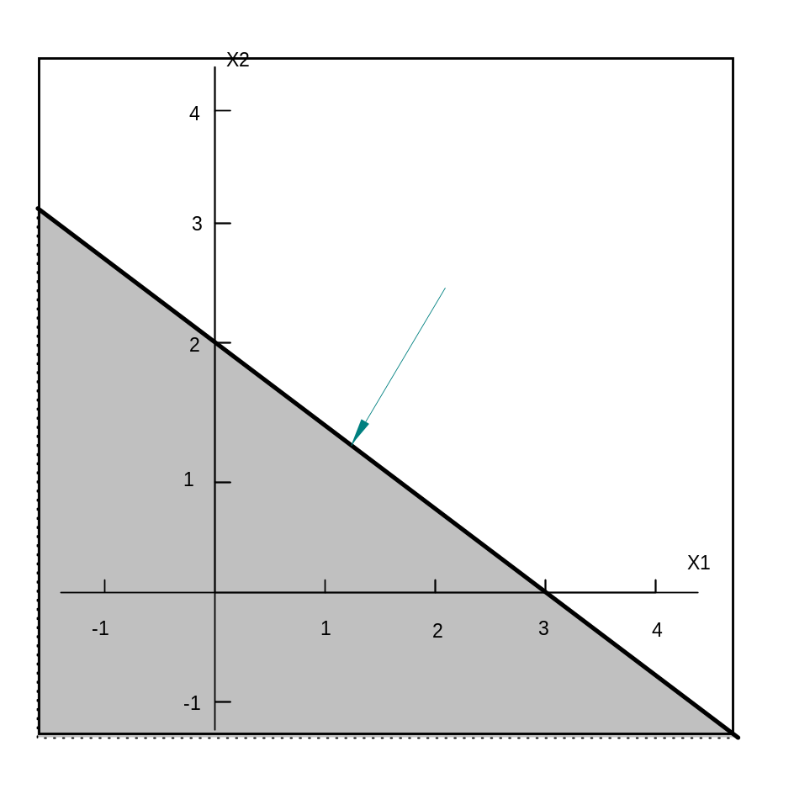
Graphical solution to a two-variable LP problem
Any LP with only two variables can be solved graphically.
  The variables are always labeled x₁ and x₂ and the coordinate axes the x₁ and x₂ axes.
Satisfies 2x₁ + 3x₂ ≥ 6
2x₁ + 3x₂ = 6
Satisfies 2x₁ + 3x₂ ≤ 6

Slide 16
Example 1 cont’d
Since the Giapetto LP has two variables, it may be solved graphically.
The feasible region is the set of all points satisfying the constraints:
    2 x₁ + x₂ ≤100 (finishing constraint)
    x₁ + x₂ ≤ 80 (carpentry constraint)
    x₁ ≤ 40 (demand constraint)
    x₁ ≥ 0 (sign restriction)
    x₂ ≥ 0 (sign restriction)

Slide 17
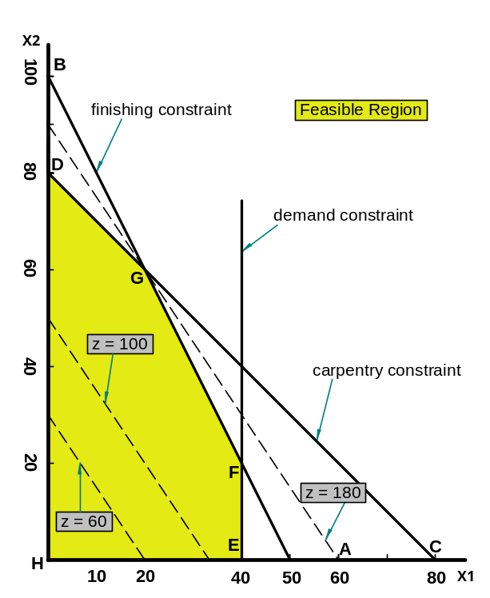
Example 1 cont’d
The set of points satisfying the Giapetto LP is bounded by the five sided polygon DGFEH. Any point on or in the interior of this polygon (the shade area) is in the feasible region.

Slide 18
Example 1 cont’d
Having identified the feasible region for the Giapetto LP, a search can begin for the optimal solution which will be the point in the feasible region with the largest z-value.
To find the optimal solution, graph a line on which the points have the same z-value. In a max problem, such a line is called an isoprofit line while in a min problem, this is called the isocost line. The figure shows the isoprofit lines for z = 60, z = 100, and z = 180.

Slide 19
Binding constraints
A constraint is binding if the left-hand and right-hand side of the constraint are equal when the optimal values of the decision variables are substituted into the constraint.
  In the Giapetto LP, the finishing and carpentry constraints are binding.
A constraint is nonbinding if the left-hand side and the right-hand side of the constraint are unequal when the optimal values of the decision variables are substituted into the constraint.
  In the Giapetto LP, the demand constraint for wooden soldiers is nonbinding since at the optimal solution (x₁ = 20), x₁ < 40.

Slide 20
Convex sets of points
A set of points S is a convex set if the line segment joining any two pairs of points in S is wholly contained in S.
For any convex set S, a point p in S is an extreme point if each line segment that lies completely in S and contains the point P has P as an endpoint of the line segment.
Extreme points are sometimes called corner points, because if the set S is a polygon, the extreme points will be the vertices, or corners, of the polygon.
  The feasible region for the Giapetto LP will be a convex set.

Slide 21
Linear programming solver
By our own hand (e.g. using Simplex method)
Using commercial solvers
  CPLEX, LINDO, …
Using MS Excel

Slide 22
Example 2 : Dorian Auto
Dorian Auto manufactures luxury cars and trucks.
The company believes that its most likely customers are high-income women and men.
To reach these groups, Dorian Auto has embarked on an ambitious TV advertising campaign and will purchase 1-minute commercial spots on two type of programs: comedy shows and football games.
Each comedy commercial is seen by 7 million high income women and 2 million high-income men and costs $50,000.
Each football game is seen by 2 million high-income women and 12 million high-income men and costs $100,000.
Dorian Auto would like for commercials to be seen by at least 28 million high-income women and 24 million high-income men.
Use LP to determine how Dorian Auto can meet its advertising requirements at minimum cost.

Slide 23
Example 2: Solution
Dorian must decide how many comedy and football ads should be purchased, so the decision variables are:
  x₁ = number of 1-minute comedy ads.
  x₂ = number of 1-minute football ads.
Dorian wants to minimize total advertising cost.
Dorian’s objective functions is:
min z = 50x₁ + 100x₂
Dorian faces the following constraints:
  Commercials must reach at least 28 million high-income women. (7x₁ + 2x₂ ≥ 28).
  Commercials must reach at least 24 million high-income men. (2x₁ + 12x₂ ≥ 24).
  The sign restrictions are necessary, so x₁, x₂ ≥ 0.

Slide 24
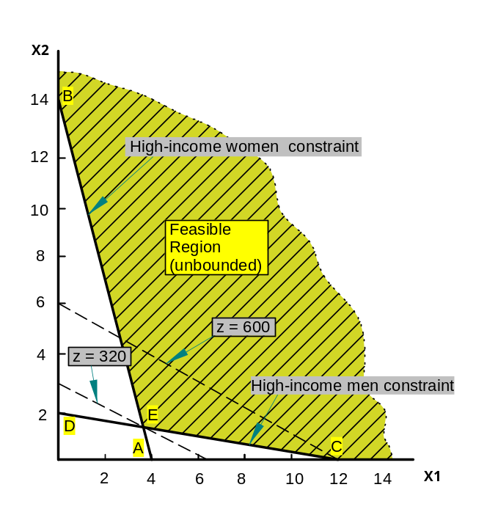
Ex. 2 – Solution continued
To solve this LP graphically begin by graphing the feasible region.

Slide 25
Ex. 2 – Solution continued
Like the Giapetto LP, The Dorian LP has a convex feasible region.
The feasible region for the Dorian problem, however, contains points for which the value of at least one variable can assume arbitrarily large values.
Such a feasible region is called an unbounded feasible region.

Slide 26
Ex. 2 – Solution continued
Since Dorian wants to minimize total advertising costs, the optimal solution to the problem is the point in the feasible region with the smallest z value.
An isocost line with the smallest z value passes through point E and is the optimal solution at x₁ = 3.6 and x₂ = 1.4.
Both the high-income women and high-income men constraints are satisfied, both constraints are binding.

Slide 27
Some problems
Does the Dorian model meet the four assumptions of linear programming?
  The proportionality assumption is violated because at a certain point advertising yields diminishing returns.
  Even though the additivity assumption was used in writing: (Total viewers) = (Comedy viewer ads) + (Football ad viewers) many of the same people might view both ads, double-counting of such people would occur thereby violating the assumption.
  The divisibility assumption is violated if only 1-minute commercials are available. Dorian is unable to purchase 3.6 comedy and 1.4 football commercials.
  The certainty assumption is also violated because there is no way to know with certainty how many viewers are added by each type of commercial.

Slide 28
Example;
Furnco manufactures desks and chairs. Each desk uses 4 units of wood, and each chair uses 3. A desk contributes $40 to profit, and a chair contributes $25.
Marketing restrictions require that the number of chairs produced be at least twice the number of desks produced.
If 20 units of wood are available, formulate an LP to maximize Furnco’s profit.
Then graphically solve the LP.

Slide 29
3.3 Special Cases
The Giapetto and Dorian LPs each had a unique optimal solution.
Some types of LPs do not have unique solutions.
  Some LPs have an infinite number of solutions (alternative or multiple optimal solutions).
  Some LPs have no feasible solutions (infeasible LPs).
  Some LPs are unbounded: There are points in the feasible region with arbitrarily large (in a maximization problem) z-values.
The technique of goal programming is often used to choose among alternative optimal solutions.

Slide 30
Alternative or Multiple Optimal Solutions
An auto company manufactures cars and trucks.
Each vehicle must be processed in the paint shop and body assembly shop.
If the paint shop were only painting trucks, then 40 per day could be painted.
If the paint shop were only painting cars, then 60 per day could be painted. If the body shop were only producing cars, then it could process 50 per day.
If the body shop were only producing trucks, then it could process 50 per day.
Each truck contributes $300 to profit, and each car contributes $200 to profit.
Use linear programming to determine a daily production schedule that will maximize the company’s profits.

Slide 31
Infeasible LP
When feasible region is empty the LP is infeasible.
Suppose that auto dealers require that the auto company in Example produce at least 30 trucks and 20 cars.
Find the optimal solution to the new LP.

Slide 32
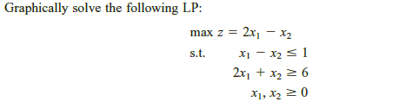
Unbounded LP
For a maximization problem, unbounded LP occurs if it is possible to find points in the feasible region with arbitrarily large z values, which corresponds to a decision maker earning arbitrarily large revenues or profits. This would indicate that an unbounded optimal solution should not occur in a correctly formulated LP.
For a minimization problem, an LP is an unbounded if there are points in the feasible region with arbitrarily small z values.

